Slide 1
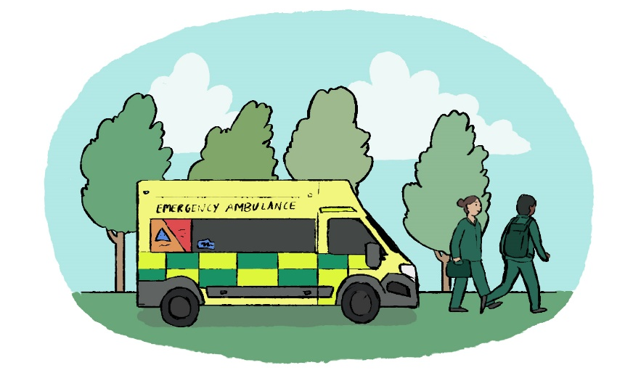
999 or not?
KS2
Every year thousands of people make 999 calls to the ambulance service, but many of them are not for emergencies. There are other services available to help people when it’s not an emergency. If you call 999 when it’s not serious, you could delay treatment for people in life threatening situations.

Slide 2
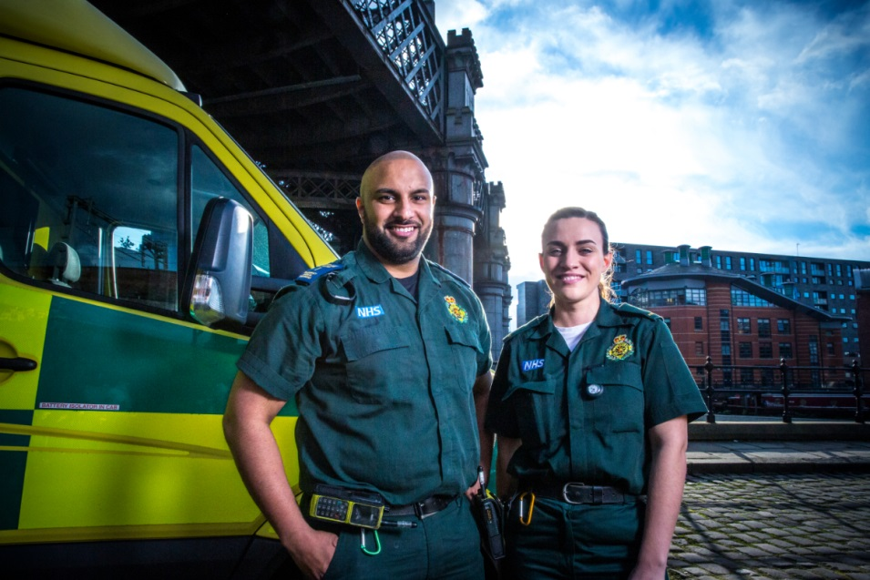
When to call 999?
Always call 999 in a medical emergency – when someone is seriously ill or injured and their life is at risk. SOME examples of genuine emergencies include:
when somebody won’t wake up
when somebody is fitting and it won’t stop
when somebody has pain in their chest
when somebody is really struggling to breathe
when somebody is bleeding a lot
when somebody has a severe allergic reaction
when someone has hurt or burnt themselves badly

Slide 3
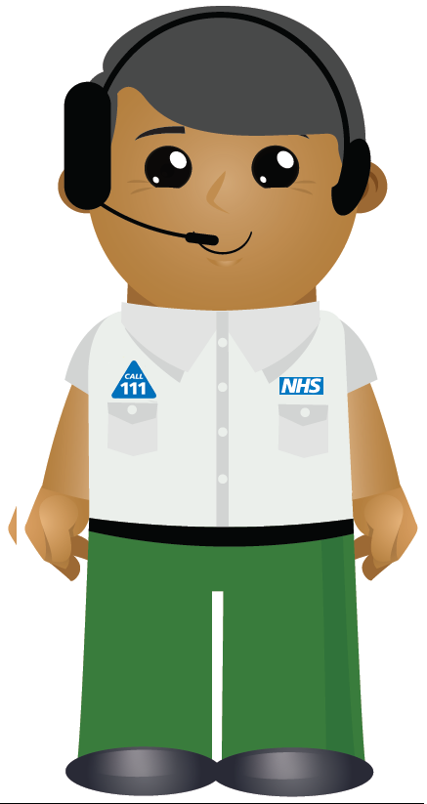
When to call 111?
If you need help when it’s not an emergency, 111 is here for you.
If you are unsure which health service you need, NHS 111 service can help you.
They could send you to the doctors, pharmacy, dentist or walk-in centre.
It could also be the hospital or an emergency ambulance if required.
What happens when you use NHS 111?
When you call NHS 111 a specially trained health advisor will ask you questions.
They will work out the best course of treatment for you.

Slide 4
Why might you go to the pharmacy or the doctor?
Pharmacy
aches and pains
sore throat
coughs
colds
flu
earache
skin rashes
teething
red eye
Doctor
When you are not getting better from your minor illness you might go to the doctor (GP) to be checked over. They may prescribe medicine to make you better. Sometimes they may refer you to another specialist doctor that works in a hospital.

Slide 5
Fairy tale scenarios
Read the stories from Happily Ever After.
How many questions can you answer correctly?

Slide 6
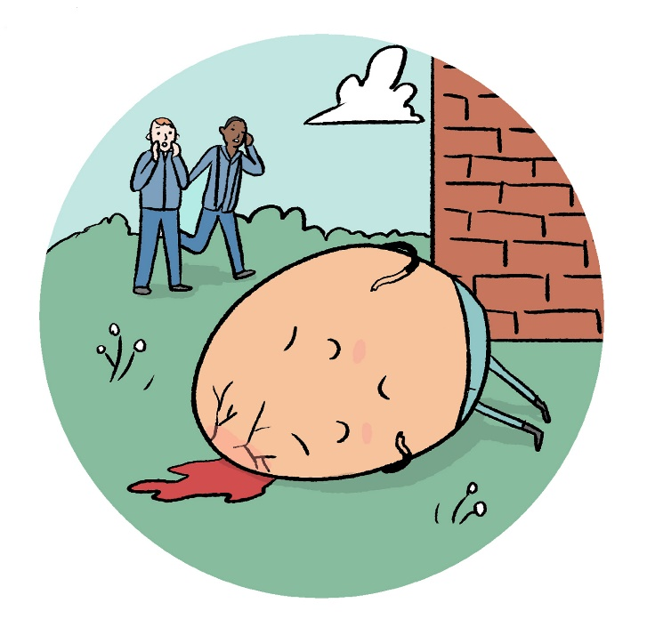
Uh oh …Humpty Dumpty is lying on the floor. He has bruised his head and a there is a big crack. There’s blood pouring from it. He has fallen awkwardly. What should the King’s men do?
A – ring 999
B – not sure ring 111
C – go home

Slide 7
You are correct! Calling 999 was the right thing to do. Humpty Dumpty has a serious head injury and is losing lots of blood. Paramedics will come in an ambulance to treat him then take him to hospital.

Slide 8
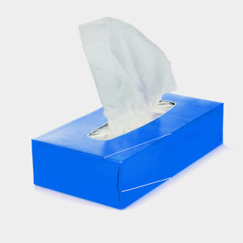
Sniffley has a cold and doesn’t want to spread his germs to his friends at work. He is coughing and sneezing. What should he do?
A – ring 999
B – not sure ring 111
C – go to the pharmacist for some medicine

Slide 9
You are correct! Going to the pharmacy for cold medicine is the best thing to do. Sniffley needs to rest at home and get better. This way he will not spread his germs to everyone else.

Slide 10
Oh no! Snow White is laid out on the floor, unconscious next to the breakfast table. Sneezey can’t wake her up. An apple with a bite out of it lies next to her. What would you do?
A – ring 999
B – not sure, ring 111
C – call the doctor

Slide 11
You are correct! Calling 999 was the correct thing to do. Snow White has had an allergic reaction to the apple. She needs to get some special medicine to make her better. Paramedics will help to relieve the symptoms of the allergic reaction and then she will get checked over at hospital.

Slide 12
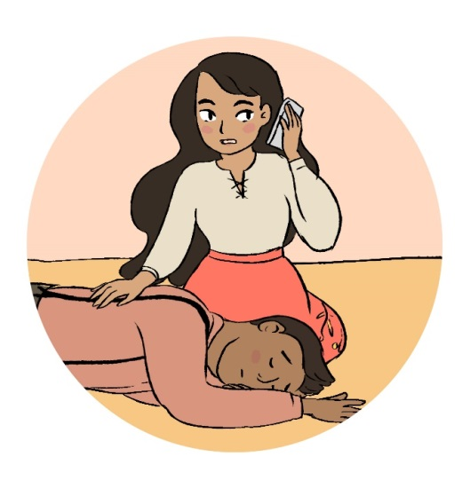
The handsome prince is totally exhausted after rescuing Sleeping Beauty. This has caused him to have a seizure. This happens to him when he over does it. Luckily for him, Sleeping Beauty acts quickly. What to do what should she do?
A – ring 111
B – call 999
C – go to the pharmacist for some medicine

Slide 13
You are correct! Sleeping Beauty called 111 for medical advice because the seizure was over quickly and she’d seen it happen to the prince before. She checked the Prince wasn’t in any danger. She took the advice of the 111 operator on the phone and stayed with the prince until he was feeling much better.

Slide 14
The witch has been baking. She accidently touched the hot tray. The burns are really bad. Her skin has turned white and red. She has blisters. She is in lots of pain. What would you do?
A – ring 999
B – not sure ring 111
C – go to the doctors

Slide 15
You are correct! Because the burns are bad it is best to call 999. The operator will help you treat the burns by putting the burn under cold water, wrapping it in cling film. The witch can then go to hospital in the ambulance where they can treat the burn and make the witch better again. What would you do if you had a little burn on your finger?

Slide 16
The gingerbread man was running too fast. He has fallen and has grazed his knee and hands! What would you do?
A – find an adult to help him clean it and apply a plaster if needed
B – call 999
C – go to the doctors
Photo credit: GETTY IMAGES

Slide 17
You are correct! Getting an adult to clean the graze with an antiseptic wipe will help the graze heal correctly. There is no need for the gingerbread man to go to hospital.

Slide 18
Oh dear! Poor Little Red Riding Hood has a very sore ear and is struggling to swallow because her throat is so sore. What would you tell her to do?
A – ring 999
B – not sure ring 111
C – go to the pharmacist

Slide 19
You are correct! Going to the pharmacy for medicine is the correct thing to do. Little Red Riding Hood needs to rest at home and get better. This way she will not spread her germs to everyone else. If she doesn’t seem to be getting better she can make an appointment with her GP.

Slide 20
Oh my goodness! One of the three little pigs has got a bad pain in his chest. He is out of breath and feels tingling in his arms. What should his brothers do immediately ?
A – ring 999
B – not sure ring 111
C – go to the pharmacist for some medicine.

Slide 21
You are correct! Calling 999 was the correct thing to do. The operator will give instructions to help save his life. The paramedics will help someone who is having a heart attack until they get to hospital for further treatment.

Slide 22
Ooops! Jack has fallen from his beanstalk. His ankle is hurting. He is struggling to walk. His mum isn’t sure if it is sprained or broken. What should he do?
A – ring 999
B – not sure ring 111
C – go to the walk in centre to get his ankle checked
Image Credit DLTK Teach

Slide 23
You are correct! Because Jack’s mum was not sure what to do, calling 111 for medical advice was the best thing to do. She took the advice of the 111 operator on the phone and took Jack in the car to the walk in centre to get his ankle checked.

Slide 24
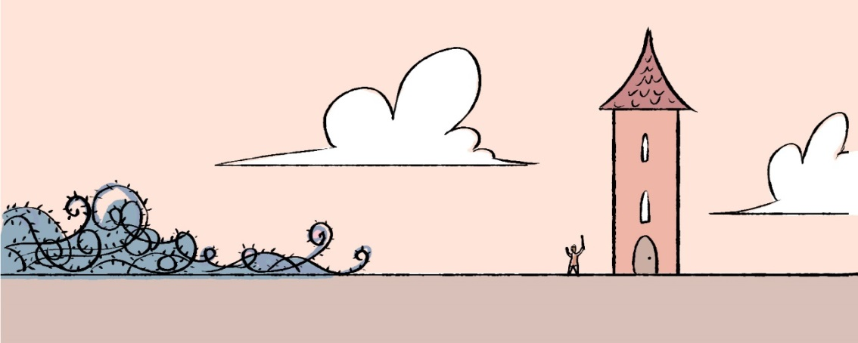
Oh dear! Rapunzel has just bumped her head with the Prince. They are both awake. Their heads are a little red and both have a small raised lump. What would you do if this had happened to you?
A – get someone to help them with some first aid
B – not sure ring 111
C – call 999

Slide 25
Yes! You can stay at home or school if you bump heads with someone and it is not serious. They can hold an ice pack (or a bag of frozen peas in a tea towel) to the injury regularly for short periods in the first few days to bring down any swelling and rest. You can take some medicine if your head hurts. An adult will keep on checking you are ok. If you feel worse you must tell them.

Slide 26
Goldilocks was helping herself to the bears’ grapes. She didn’t chop them in half and now one is stuck in her throat. Luckily the three bears have just got back. Mummy bear is trying to get it out. What should daddy bear do ?
A – ring 999
B – ring 111
C – go to the pharmacist
Image Credit: First Cry Parenting

Slide 27
You are correct! Calling 999 is the correct thing to do. Goldilocks is choking is struggling to breathe. Mummy bear cannot get the grape out so an ambulance is on its way. The paramedics will try to get the grape out and/or help her to breathe, then she can be taken to hospital to be checked.

Slide 28
Where can you get help?

Slide 29
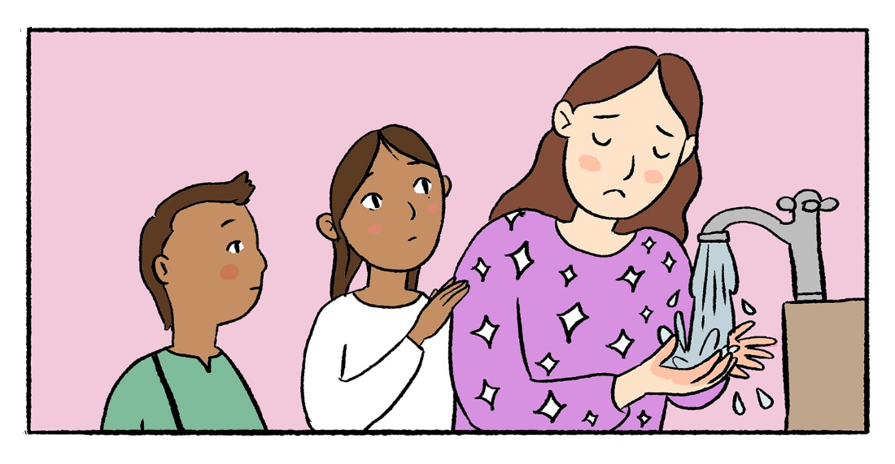
What to do in an emergency
stay calm.
find an adult to help you.
If there is no adult around, ring 999, explain what has happened and ask for the police, fire brigade, an ambulance or the coastguard.
* Did you know you can also dial 112 to reach the emergency services?

Slide 30
www.nwas.nhs.uk

